Slide 1

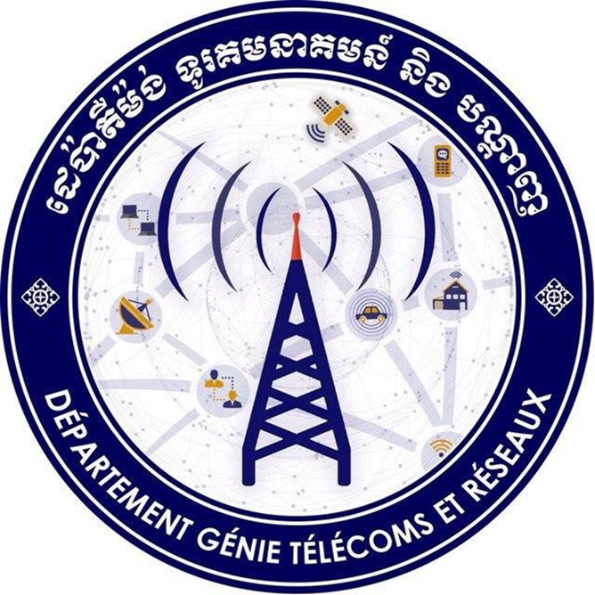
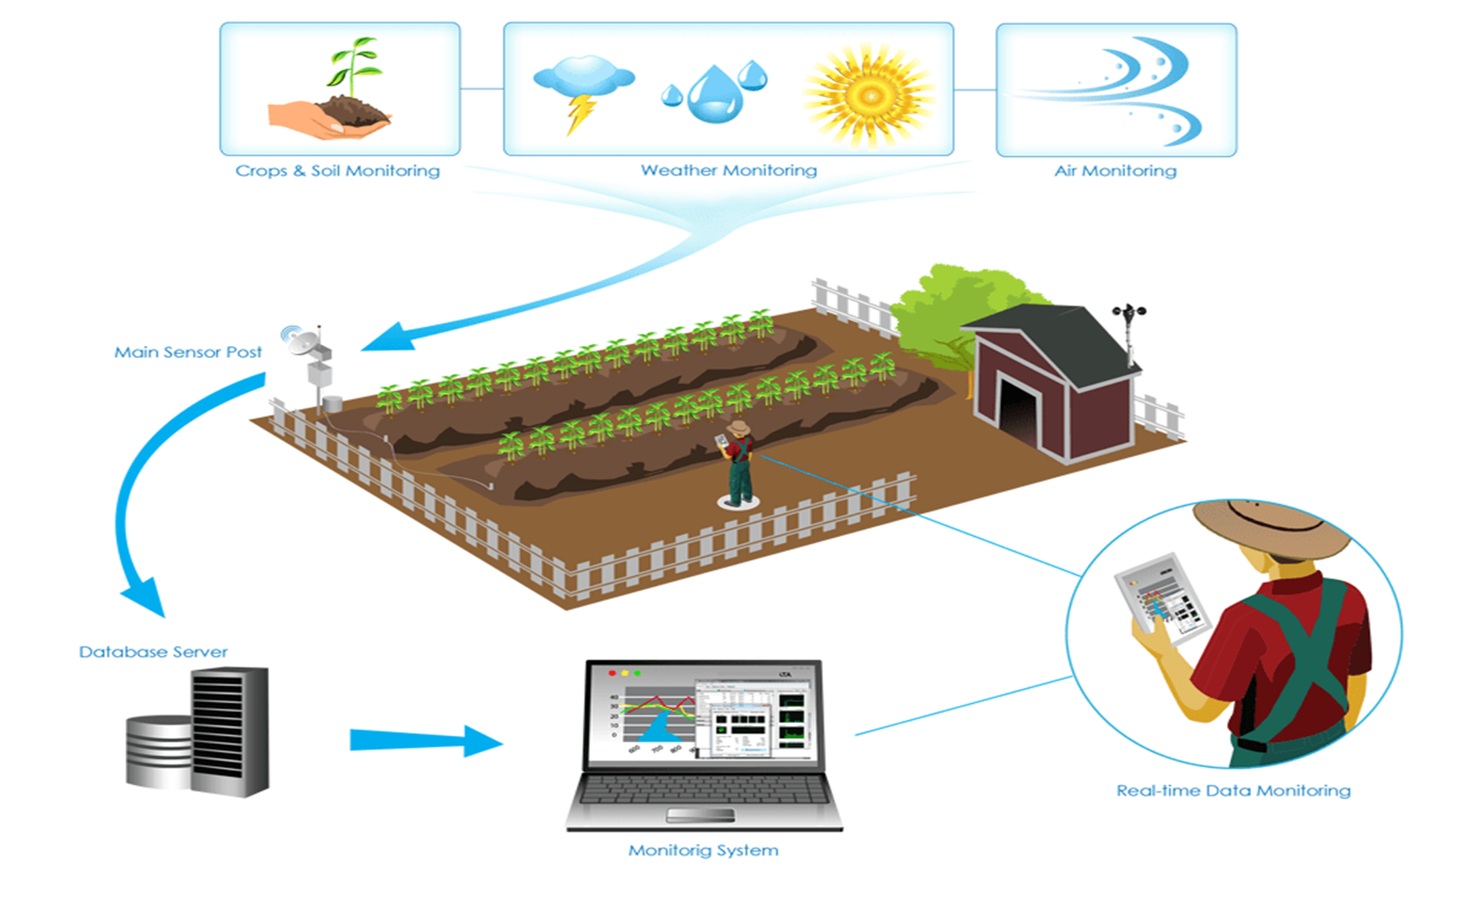
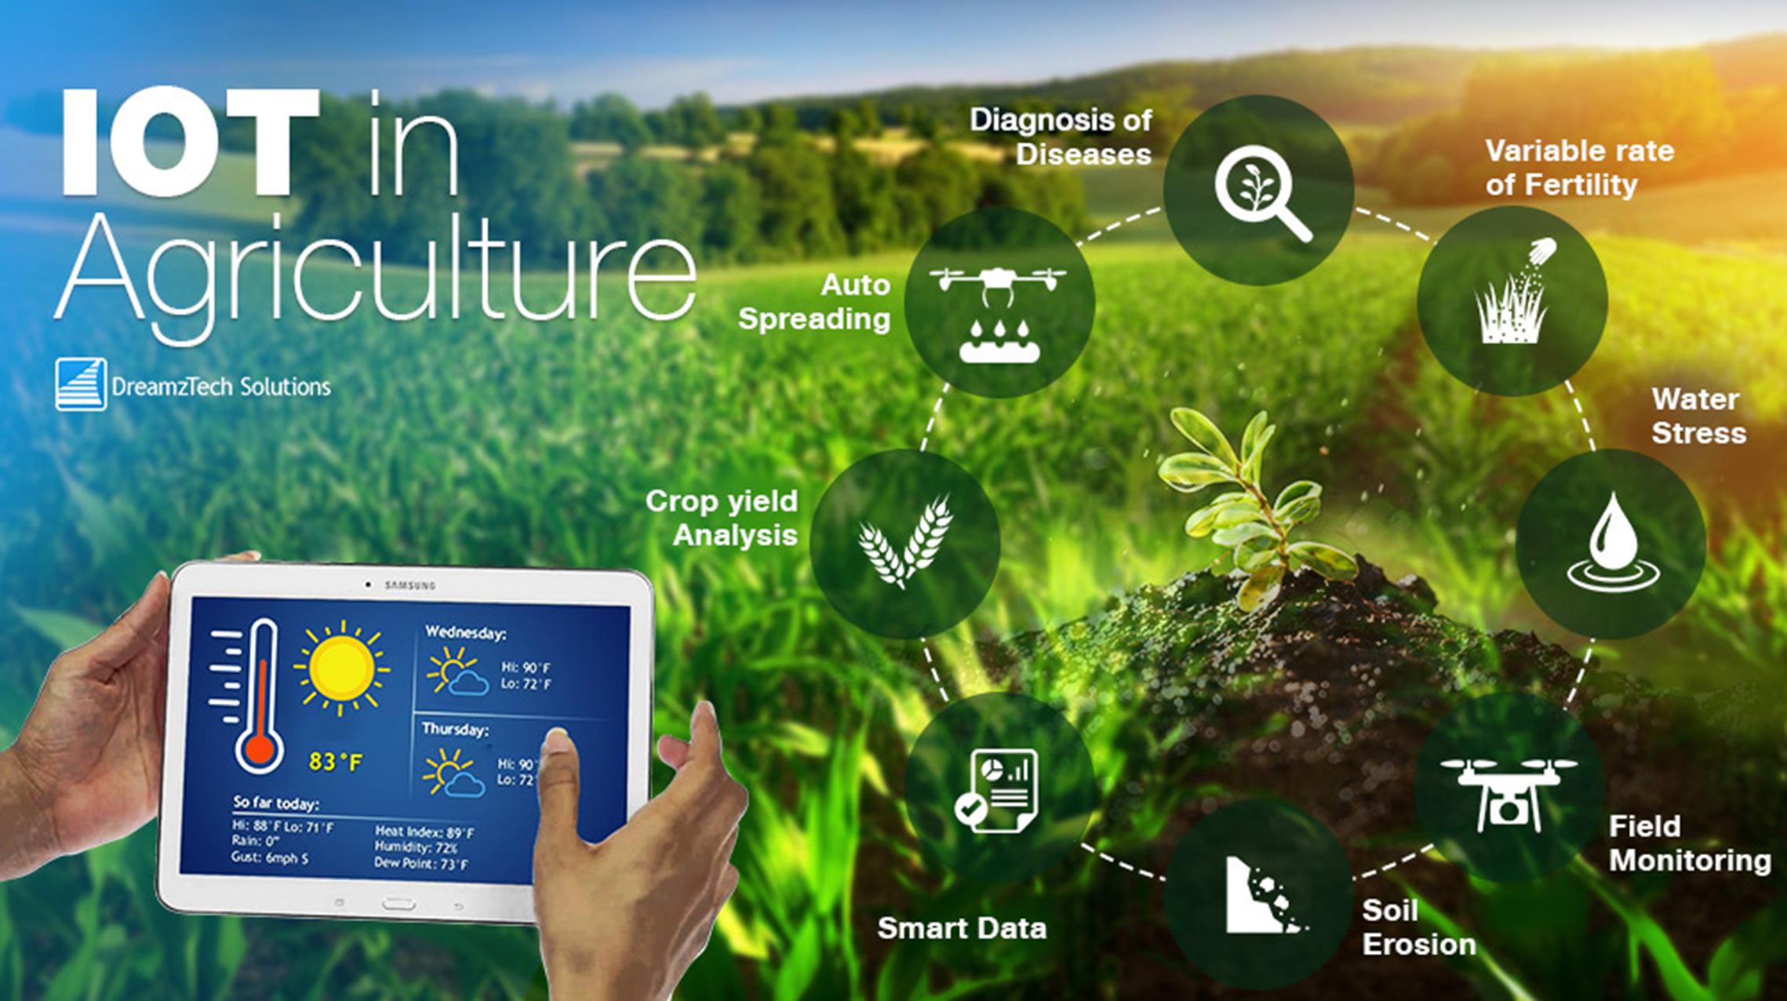
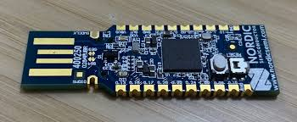
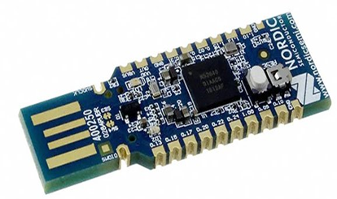
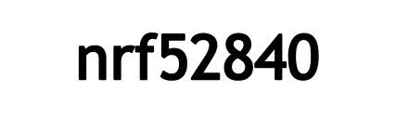
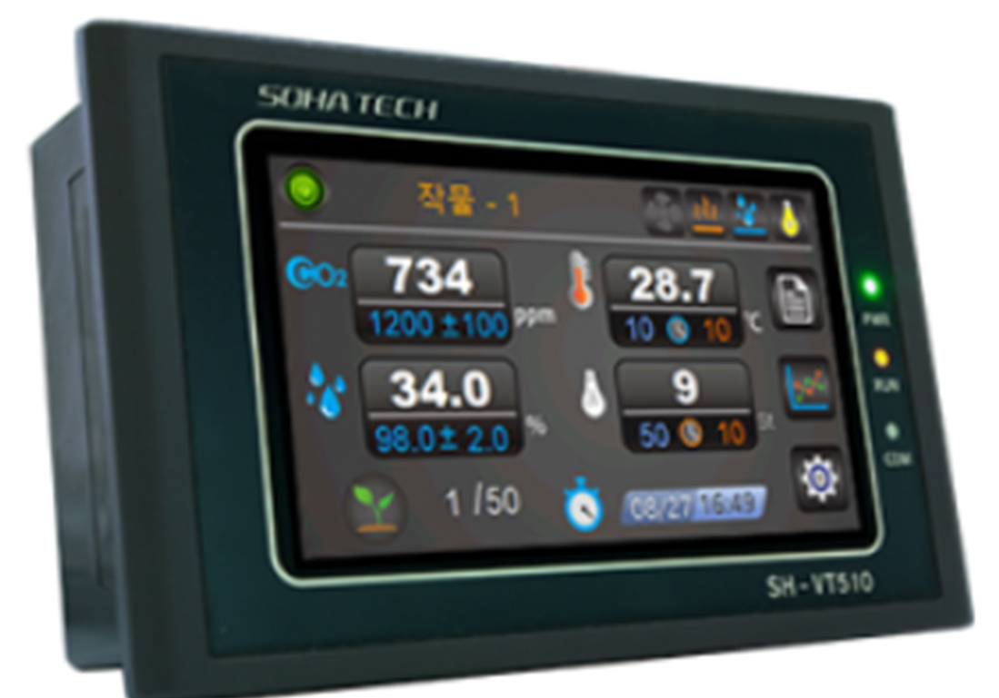
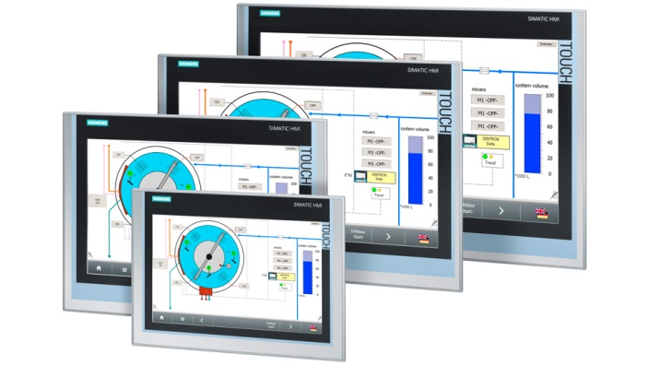
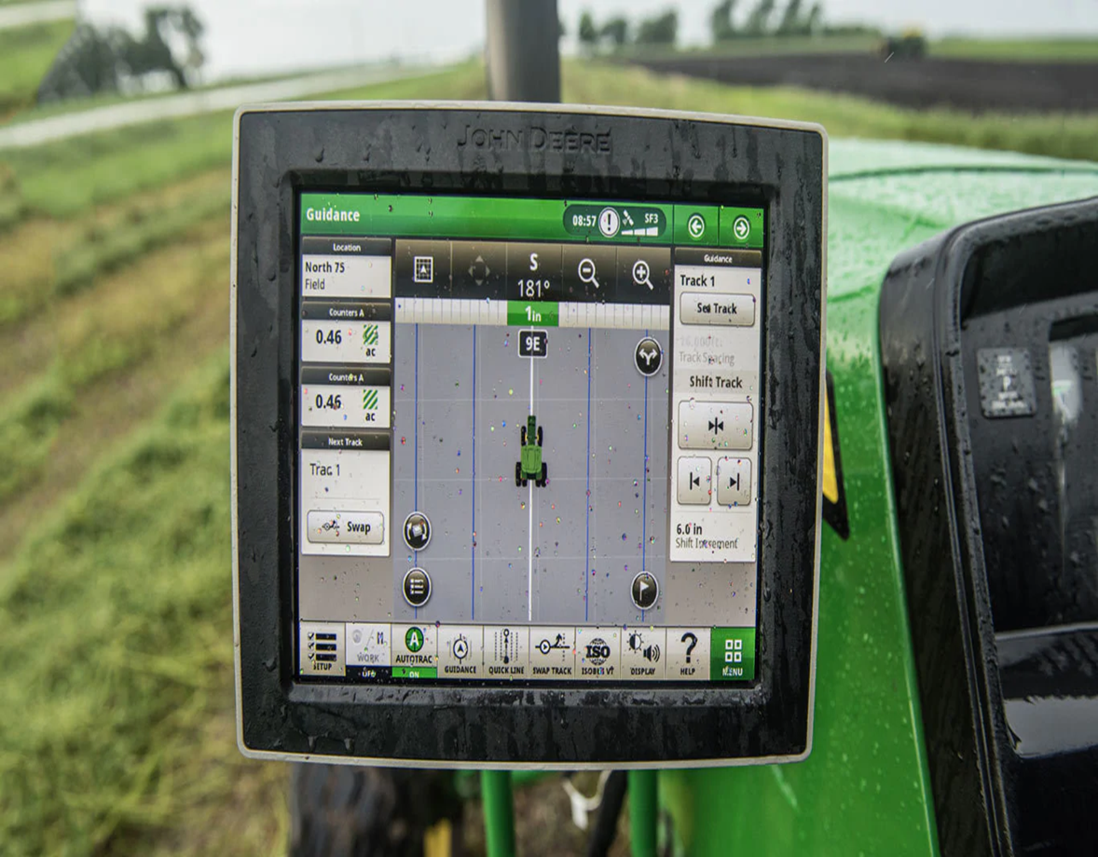
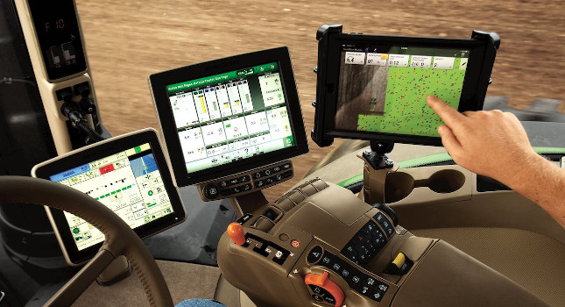
Smart Human Machine Interface ”HMI”
MANTOR : HEL CHANTHAN
TEB SOVICHEA
Student: BIN CHANTHY
INTRODUCTION
OBJECTIVES
This project is designed to facilitate farmers to check the amount of water, temperature, and soil moisture in the soil. To make it easier for farmers, I also included data in the HMI associated with nrf52840 in order to automatically turn on and off the water on the HMI screen.
This project I design a screen on nx8048k050 (HMI) for input related data and output and for the convenience of farmers. By setting up a program to view the temperature, weather data, water volume data in conjunction with the nrf52840 device for entering data for farmers to control.
Fig.1 The Proposed Smart HMI
Fig. view data
ARCHITECTURE
PROCESSING
This project is designed to make it easier for farmers to check the crop have for lack of water or insufficient temperature for the crop. It will display all the data on the screen of the farmer's .
Arduino is used to integrating software into nrf52840 and HMI. nrf52840 Used to receive data and input that data to the device. The device also provides feedback for checking the temperature, soil moisture, and weather in the crop to the HMI. HMI is a system that can control and stop all systems.
Fig.3 Farmers data
HMI is also a control unit for controlling the throttle of water for crops. And also ordered to the various pagodas that are in the picture.
Fig.4 HMI control
Fig.5 Smart HMI
CONCLUSIONS
The project is designed to reduce farmers' efforts to grow crops by switching from direct viewing to technical viewing. After the completion of this project, farmers will be able to use the cultivation techniques without using force as before. In the future, there will be more technology for farmers to grow their crops. . For all the details on the farm and enter the data on the screen via Bluetooth.
Fig.6 The farmer user HMI

